Slide 1


GLOBAL UNIVERSITY ANALYSIS
Project by:- Ajmal, Amaan & Ankit

Slide 2






COMPREHENSIVE ANALYSIS
Mumbai University
OVERVIEW
The "Global University Analytics Success" dashboard provides an in-depth analysis of higher education trends worldwide. It evaluates university performance across different countries, offering insights into national education systems. The dashboard further breaks down university-specific data, including ranking positions and key success metrics. By incorporating a yearly analysis, it highlights shifts in global rankings and educational outcomes over time. This comprehensive tool enables stakeholders to track trends, assess progress, and make data-driven decisions in the academic sector.

Slide 3



Mumbai University
OBJECTIVE
The goals of this project are to assess and compare university rankings, pinpoint the crucial factors shaping these rankings, and analyze regional trends. Through these objectives, we aim to provide a deeper understanding of the dynamics behind university positions in various ranking systems.

Slide 4
Mumbai University
SIGNIFICANCE
This project holds substantial significance in enhancing our comprehension of university performance and the analysis of diverse ranking systems. Seeking to offer valuable insights into the factors influencing the success of universities, contributes to the ongoing efforts to understand and improve the higher education landscape.

Slide 5





DATASET
Mumbai University
Dataset Description:
This dataset provides information on university rankings from various systems, including ranking criteria and university-specific data.
Table Explanations:
1. country:
- Description: A list of countries included in the dataset.
- Note: While not exhaustive, it encompasses a representative set of countries for the scope of this dataset.
2. university:
- Description: A list of universities ranked within the specified systems.
- Note: Each university is associated with a specific country.
3. ranking system:
Description: This table outlines the three distinct ranking systems used: Times Higher Education World University Ranking, Shanghai Ranking, and Center for World University Rankings.
4. ranking criteria:
Description: This table details the various criteria employed by each ranking system, such as Citations and Quality of Education.
Note: It also includes criteria contributing to the Total Score for each respective system.
5. university year:
- Description: Contains values for measurements such as the number of students and the student-to-staff ratio for each university over several years.
6. university ranking year:
- Description: This table includes the score for each year for each university, along with ranking criteria.

Slide 6



DATA PREPROCESSING
Mumbai University
During the data preprocessing for the "Global University Analytics Success" dashboard, I conducted thorough data cleaning, eliminating missing values, duplicates, and ensuring consistency in university names and country data. In the data transformation phase, I created new measures like student success rates and faculty-to-student ratios to provide insightful metrics. Additionally, I utilized quick measures to automate calculations for yearly trends and regional ranking comparisons and many more. To optimize performance, I applied data reduction techniques by filtering out irrelevant columns and focusing on key variables such as university rankings, research output, and graduation rates. This streamlined the dataset and ensured that the dashboard delivered meaningful insights.

Slide 7
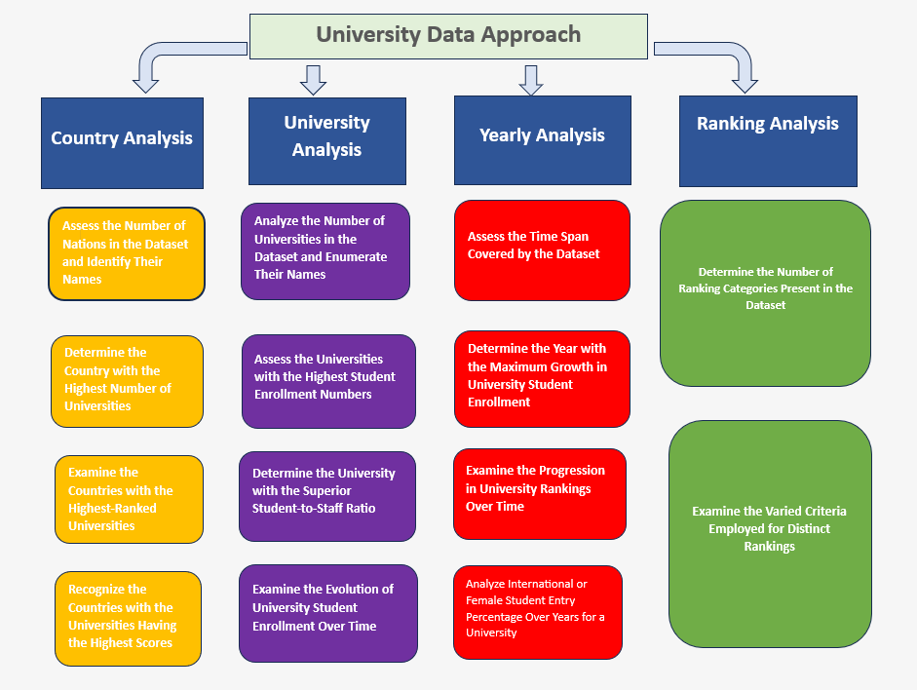
Mumbai University

Slide 8
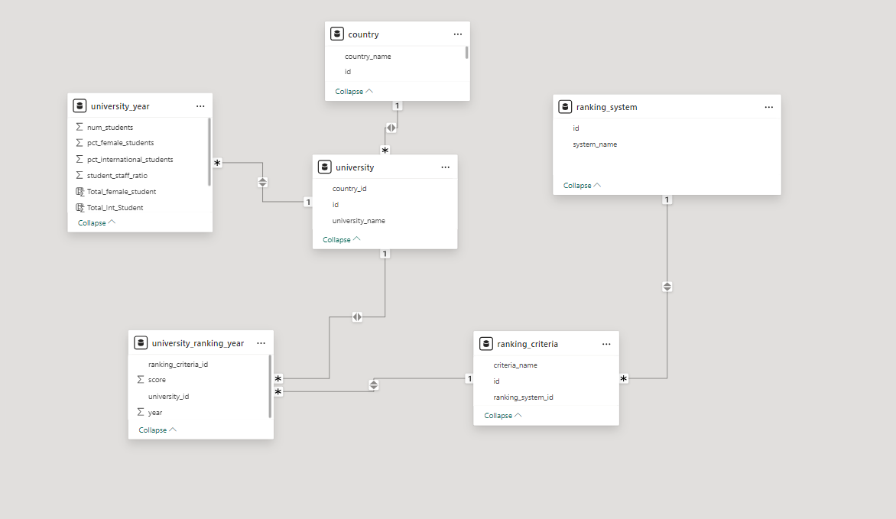
MODEL VIEW
Mumbai University

Slide 9
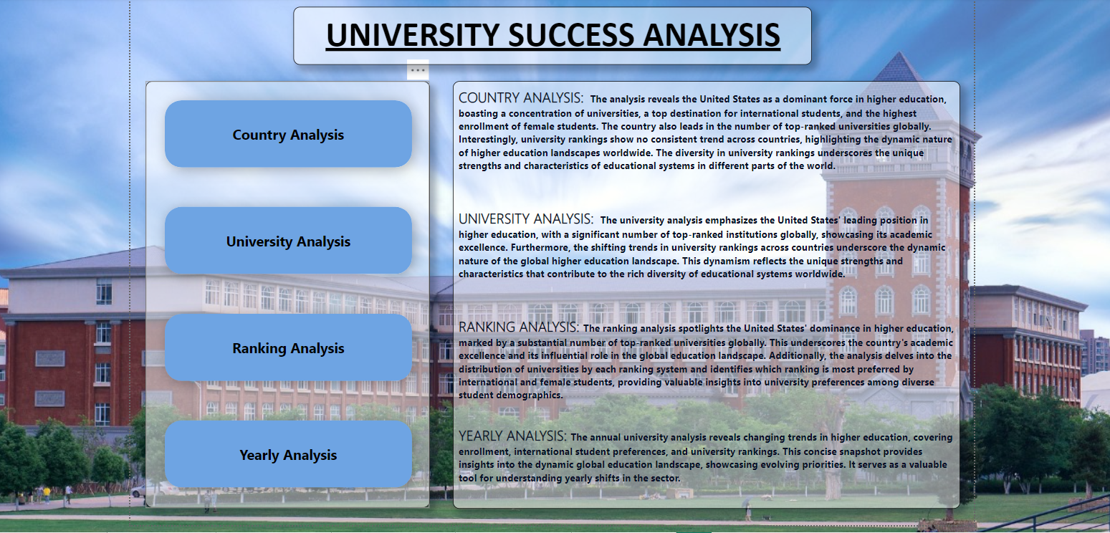

Home Page of Dashboard
Mumbai University

Slide 10
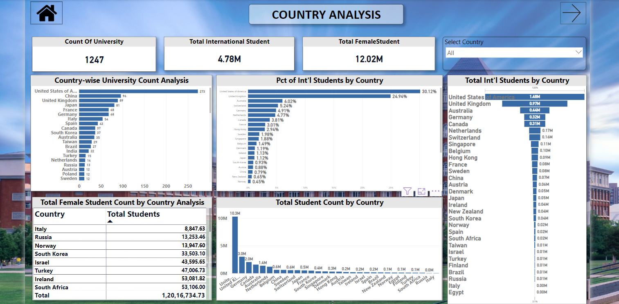
Country Analysis
Mumbai University

Slide 11
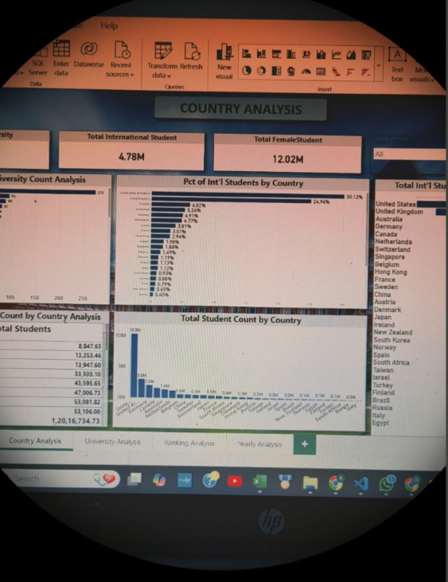
Mumbai University
Insights:-
The United States is a dominant player in higher education, hosting the highest number of universities and the largest population of international students.
United Kingdom, Australia, Germany, and Canada also rank among the top for international student numbers and percentages.
In terms of female students, South Korea, Turkey, and Israel have significant representation.
This dashboard provides a comprehensive comparison of international students across various countries, illustrating global trends in higher education.

Slide 12
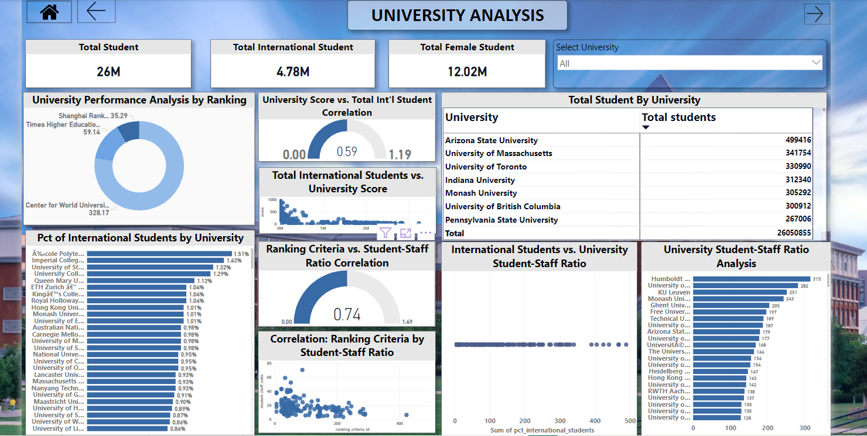
University Analysis
Mumbai University

Slide 13

Mumbai University
Insights:-
Universities with higher rankings tend to attract more international students and have better student-staff ratios.
Institutions like Arizona State University, University of Massachusetts, and University of Toronto lead in total student population.
Universities such as École Polytechnique, Imperial College, and University of St Andrews have a high percentage of international students.
A favorable student-staff ratio is positively correlated with a university’s global ranking, implying that quality education and ranking are closely tied to faculty size.
This analysis highlights the performance of global universities in attracting international students and maintaining competitive academic staff ratios, contributing to their rankings.

Slide 14
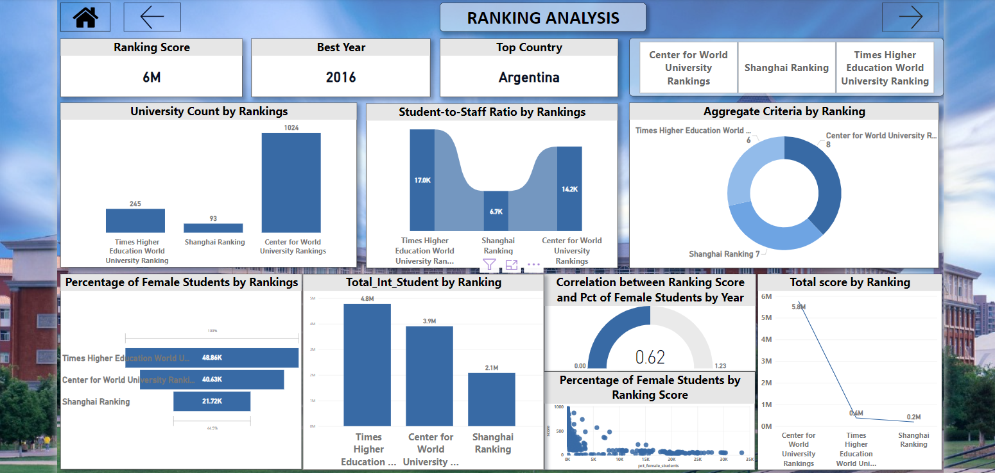
Ranking Analysis
Mumbai University

Slide 15

Mumbai University
Insights:-
CWUR dominates in terms of the number of ranked universities and overall score, followed by Times Higher Education and Shanghai Ranking.
Times Higher Education has the best student-to-staff ratio and the highest percentage of female students.
There’s a moderate positive correlation between ranking scores and the percentage of female students, indicating that higher-ranked universities tend to have a better gender balance.
2016 was the best year for rankings, and Argentina emerges as the top country, reflecting notable performance during that period.
This dashboard effectively compares university rankings across different systems and highlights the impact on student representation, diversity, and faculty resources.

Slide 16
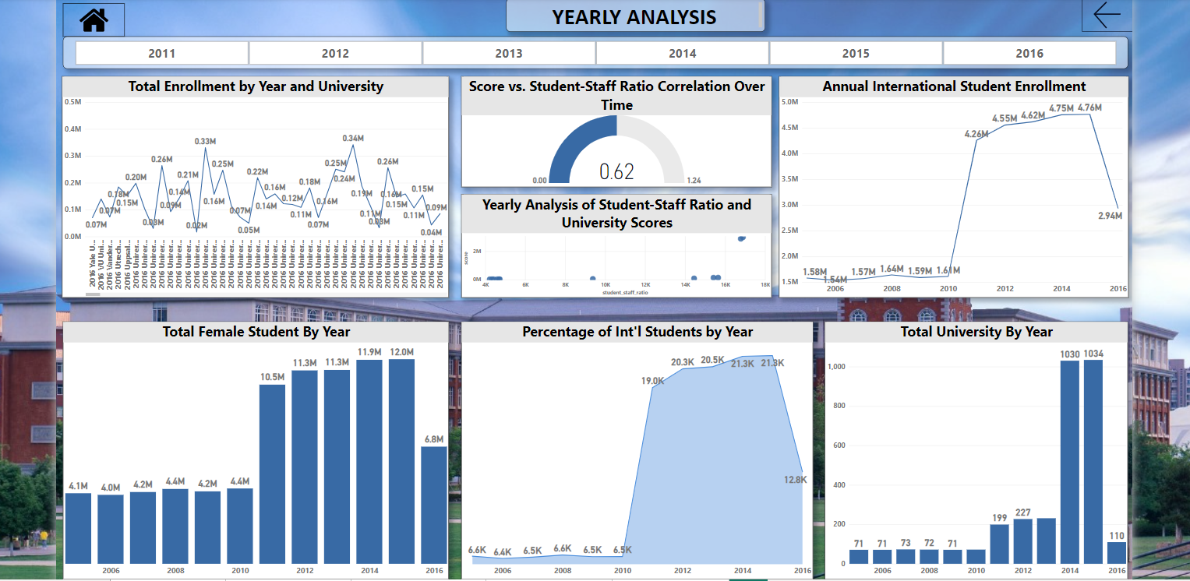
Yearly Analysis
Mumbai University

Slide 17

Mumbai University
Insights:-
2013 and 2015 were peak years for total student enrollment, while 2016 experienced a decline. International student enrollment saw steady growth, peaking in 2014 and 2015, but sharply dropped in 2016.
Female student participation steadily increased, reaching its highest in 2016 with 12 million students, highlighting a strong upward trend in gender diversity.
The percentage of international students rose significantly between 2006 and 2014, with a peak of 21.3%, before declining to 12.8% in 2016.
The number of universities expanded rapidly, especially after 2012, reaching over 1,000 universities by 2016, reflecting global educational growth.
A moderate positive correlation (0.62) between the student-staff ratio and university scores indicates that better-resourced universities tend to rank higher.
This dashboard compares trends in student enrollment, gender diversity, international presence, and institutional growth across different years, revealing their impact on higher education systems.

Slide 18
Mumbai University
REFERENCE
Link Name:
﻿Brief Description:
Link Name:
﻿Brief Description:
Link Name:
﻿Brief Description:

Slide 19

DO YOU HAVE ANY QUESTION?

Slide 20


THANK
YOU
FOR YOUR ATTENTION

